Slide 1
Routing protocols for wireless ad hoc Networks
Sankhayan Choudhury
University of Calcutta
Notes:
This template can be used as a starter file for presenting training materials in a group setting.
Sections
Right-click on a slide to add sections. Sections can help to organize your slides or facilitate collaboration between multiple authors.
Notes
Use the Notes section for delivery notes or to provide additional details for the audience. View these notes in Presentation View during your presentation.
Keep in mind the font size (important for accessibility, visibility, videotaping, and online production)
Coordinated colors
Pay particular attention to the graphs, charts, and text boxes.
Consider that attendees will print in black and white or grayscale. Run a test print to make sure your colors work when printed in pure black and white and grayscale.
Graphics, tables, and graphs
Keep it simple: If possible, use consistent, non-distracting styles and colors.
Label all graphs and tables.

Slide 2
Outline
Wireless Networks: Classifications
Challenges: Ad-hoc Network & Design issues
Adhoc Routing: Requirements
Adhoc Routing: Classification
Reactive Roting
Pro-active Routing
Hybrid Routing

Slide 3
Wireless Networks
Need: Access computing and communication services, on the move
Infrastructure-based Networks
traditional cellular systems (base station infrastructure)
Wireless LANs
Infrared (IrDA) or radio links (Wavelan)
very flexible within the reception area; ad-hoc networks possible
low bandwidth compared to wired networks (1-10 Mbit/s)
Ad hoc Networks
useful when infrastructure not available, impractical, or expensive
military applications, rescue, home networking

Slide 4
Cellular Networks
Single hop wireless connectivity to the wired world
Space divided into cells
A base station is responsible to communicate with hosts in its cell
Mobile hosts can change cells while communicating
Hand-off occurs when a mobile host starts communicating via a new base station

Slide 5
Multi-hop Wireless
May need to traverse multiple links to reach destination
Mobility causes route change

Slide 6
Ad-hoc Networks
Host movement frequent
Topology change frequent
No cellular infrastructure. Multi-hop wireless links.
Data must be routed via intermediate nodes.
B
A
A
B

Slide 7
Why Ad Hoc Networks ?
Setting up of fixed access points and backbone infrastructure is not always viable
Infrastructure may not be present in a disaster area or war zone
Infrastructure may not be practical for short-range radios; Bluetooth (range ~ 10m)
Ad hoc networks:
Do not need backbone infrastructure support
Easy to deploy
Useful when infrastructure is absent, destroyed or impractical

Slide 8
Applications
Personal area networking
cell phone, laptop, ear phone, wrist watch
Military environments
soldiers, tanks, planes
Civilian environments
taxi cab network
meeting rooms
sports stadiums
boats, small aircraft
Emergency operations
search-and-rescue
policing and fire fighting

Slide 9
Challenges
Limitations of the Wireless Network
packet loss due to transmission errors
variable capacity links
frequent disconnections/partitions
limited communication bandwidth
Broadcast nature of the communications
Limitations Imposed by Mobility
dynamically changing topologies/routes
lack of mobility awareness by system/applications
Limitations of the Mobile Computer
short battery lifetime
limited capacities

Slide 10
Adhoc Routing: Requirements
Fully distributed, no critical nodes
Allow for random node events (e.g. entering, leaving, neighbor changes)
Minimum delay to determine path (at transmission time)
Minimize storage requirements
Must remove (or not propagate) invalid paths

Slide 11
Unicast Routing
Many protocols have been proposed
Some specifically invented for MANET
Others adapted from protocols for wired networks
No single protocol works well in all environments
some attempts made to develop adaptive/hybrid protocols

Slide 12
Classifications: Routing
Proactive protocols
Traditional distributed shortest-path protocols
Maintain routes between every host pair at all times
Based on periodic updates; High routing overhead
Example: DSDV (Destination Sequenced Distance Vector)
Reactive protocols
Determine route if and when needed
Source initiates route discovery
Example: DSR (Dynamic Source Routing)
Hybrid protocols
Adaptive; Combination of proactive and reactive
Example : ZRP (Zone Routing Protocol)

Slide 13
Routing: Features
Proactive protocols
Always maintain routes
Little or no delay for route determination
Consume bandwidth to keep routes up-to-date
Maintain routes which may never be used
Reactive protocols
Lower overhead since routes are determined on demand
Significant delay in route determination
Employ flooding (global search)
Control traffic may be bursty
Which approach achieves a better trade-off?
It depends on the traffic and mobility patterns

Slide 14
Ad hoc routing protocols – classification
When?
Option 1: Routing protocol always tries to keep its routing data up-to-date
Protocol is proactive (active before tables are actually needed) or table-driven
Option 2: Route is only determined when actually needed
Protocol operates on demand
Option 3: Combine these behaviors
Hybrid protocols

Slide 15
Ad hoc routing protocols – classification
Network Structure : flat or hierarchical?
– Flat addressing scheme similar to IEEE 802.3 LANs
– Globally unique addressing mechanism for nodes
Compare topology control, traditional routing
Which data is used to identify nodes?
An arbitrary identifier?
The position of a node?
geographic routing protocols because choice of next hop neighbor can be computed based on destination address
Identifiers that are not arbitrary, but carry some structure?
As in traditional routing
Structure akin to position, on a logical level?

Slide 16
Classification (cont.)
Ad Hoc Routing Protocols
Proactive
Hybrid
Reactive
Table driven
Hybrid
Source-initiated
on-demand
DSDV
OSLR
WRP
ZRP
CGSR
AODV
DSR
TORA
ABR
SSR

Slide 17
Dynamic Source Routing (DSR)
Cooperative nodes
Relatively small network diameter (5-10 hops)
Detectable packet error
Unidirectional or bidirectional link
Promiscuous mode (optional)

Slide 18
DSR : Reactive Protocol
In a reactive protocol, how to forward a packet to destination?
Initially, no information about next hop is available at all
One (only?) possible recourse: Send packet to all neighbors – flood the network
Hope: At some point, packet will reach destination and an answer is sent back – use this answer for backward learning the route from destination to source
Practically: Dynamic Source Routing (DSR)
Use separate route request/route reply packets to discover route
Data packets only sent once route has been established
Discovery packets smaller than data packets
Store routing information in the discovery packets

Slide 19
Phases
Route discovery
When node S wants to send a packet to node D, but does not know a route to D, node S initiates a route discovery
Route maintenance
Mechanisms “on-demand”
No periodic routing advertisement
No link status sensing
No neighbor detection packets
Routes caching

Slide 20
DSR
Source node S floods Route Request (RREQ) to its’ neighbors
Each node appends own identifier in the header when forwarding RREQ and floods the message
The destination responds with a Route Reply message containing the path

Slide 21
Dynamic Source Routing (DSR)
Node S on receiving RREP, caches the route included in the RREP
When node S sends a data packet to D, the entire route is included in the packet header
hence the name source routing
Intermediate nodes use the source route included in a packet to determine to whom a packet should be forwarded

Slide 22
DSR
A node can only flood the RouteRequestpacket if it has not already flooded it
On link failure:
Adjacent node sends a RouteErrormessage to the source
The source will remove the route from its route entry list

Slide 23

Route Discovery in DSR
Y
Z
S
E
F
B
C
M
L
J
A
G
H
D
K
I
N
Represents a node that has received RREQ for D from S

Slide 24
Route Discovery in DSR
Y
Broadcast transmission
[S]
Z
S
E
F
B
C
M
L
J
A
G
H
D
K
I
N
Represents transmission of RREQ
[X,Y] Represents list of identifiers appended to RREQ

Slide 25
Route Discovery in DSR
Y
Z
S
E
[S,E]
F
B
C
M
L
J
A
[S,C]
G
H
D
K
I
N
Node H receives packet RREQ from two neighbors:
potential for collision

Slide 26
Route Discovery in DSR
Y
Z
S
E
F
[S,E,F]
B
C
M
L
J
A
G
H
D
K
I
[S,C,G]
N
Node C receives RREQ from G and H, but does not forward
it again, because node C has already forwarded RREQ once

Slide 27
Route Discovery in DSR
Y
Z
S
E
F
[S,E,F,J]
B
C
M
L
J
A
G
H
D
K
I
[S,C,G,K]
N
Nodes J and K both broadcast RREQ to node D
Since nodes J and K are hidden from each other, their
transmissions may collide

Slide 28
Route Discovery in DSR
Y
Z
S
E
F
[S,E,F,J,M]
B
C
M
L
J
A
G
H
D
K
I
N
Node D does not forward RREQ, because node D
is the intended target of the route discovery

Slide 29
Route Discovery in DSR
Destination D on receiving the first RREQ, sends a Route Reply (RREP)
RREP is sent on a route obtained by reversing the route appended to received RREQ
RREP includes the route from S to D on which RREQ was received by node D

Slide 30
Route Reply in DSR
Y
Z
S
E
RREP [S,E,F,J,D]
F
B
C
M
L
J
A
G
H
D
K
I
N
Represents RREP control message

Slide 31
Data Delivery in DSR
Y
DATA [S,E,F,J,D]
Z
S
E
F
B
C
M
L
J
A
G
H
D
K
I
N
Packet header size grows with route length

Slide 32
DSR Optimization: Route Caching
Each node caches a new route it learns by any means
When node S finds route [S,E,F,J,D] to node D, node S also learns route [S,E,F] to node F
When node K receives Route Request [S,C,G] destined for node, node K learns route [K,G,C,S] to node S
When node F forwards Route Reply RREP [S,E,F,J,D], node F learns route [F,J,D] to node D
When node E forwards Data [S,E,F,J,D] it learns route [E,F,J,D] to node D
A node may also learn a route when it overhears Data
Problem: Stale caches may increase overheads

Slide 33
Dynamic Source Routing: Advantages
Routes maintained only between nodes who need to communicate
reduces overhead of route maintenance
Route caching can further reduce route discovery overhead
A single route discovery may yield many routes to the destination, due to intermediate nodes replying from local caches

Slide 34
Dynamic Source Routing: Disadvantages
Packet header size grows with route length due to source routing
Flood of route requests may potentially reach all nodes in the network
Potential collisions between route requests propagated by neighboring nodes
insertion of random delays before forwarding RREQ
Increased contention if too many route replies come back due to nodes replying using their local cache
Route Reply Storm problem
Stale caches will lead to increased overhead

Slide 35
Route Discovery
RREQ FORMAT
B
Initiator ID
A-B-D-G
A-B-D-G
G
Initiator seq#
A-B-D-G
A-B
Target ID
A
D
A-B-D
Partial route
A
A-C-E
A
E
H
A-B-C
A-C-E
Route Request (RREQ)
A-C-E
C
A-C
A-B-C
F
Route Reply (RREP)
Route Discovery is issued with exponential back-off intervals.

Slide 36
Route Discovery: at source A
A need to send to G
Lookup Cache for route A to G
Route found?
Start Route Discovery Protocol
no
Buffer packet
Continue normal processing
yes
wait
yes
Write route in packet header
Packet in buffer?
Route Discovery finished
Send packet to next-hop
no
done

Slide 37
Route Discovery: At an intermediate node
<src,id> in recently seen requests list?
Accept route request packet
Discard route request
yes
no
Host’s address already in patrial route
yes
Discard route request
Append myAddr to partial route
no
no
myAddr=target
Store <src,id> in list
yes
Send route reply packet
Broadcast packet
done

Slide 38
Route Maintenance
Route maintenance performed only while route is in use
Error detection:
Monitors the validity of existing routes by passively listening to data packets transmitted at neighboring nodes
Lower level acknowledgements
When problem detected, send Route Error packet to original sender to perform new route discovery
Host detects the error and the host it was attempting;
Route Error is sent back to the sender the packet – original src

Slide 39
Route Maintenance
B
RERR
G
RERR
D
G
A
Route Cache (A) G: A, B, D, G G: A, C, E, H, G F: B, C, F
E
H
C
F

Slide 40
Destination Sequenced Distance Vector (DSDV)
Based on Bellman-Ford algorithm
Enhanced with sequence number to avoid loops
Fresher routes have higher sequence numbers
Optimizations added to reduce routing overheads – incremental data exchange, delayed exchange of updates

Slide 41
Destination-Sequenced Distance-Vector (DSDV)
Each node maintains a routing table that stores
next hop, cost metric towards each destination
a sequence number that is created by the destination itself
Each node periodically forwards routing table to neighbors
Each node increments and appends its sequence number when sending its local routing table
Each route is tagged with a sequence number; routes with greater sequence numbers are preferred
Each node advertises a monotonically increasing even sequence number for itself
Traffic overhead even if there is no change in network topology
Maintains routes which are never used

Slide 42
Destination-Sequenced Distance-Vector
X
Y
Z
When X receives information from Y about a route to Z
Let destination sequence number for Z at X be S(X), S(Y) is sent from Y
If S(X) > S(Y), then X ignores the routing information received from Y
If S(X) = S(Y), and cost of going through Y is smaller than the route known to X, then X sets Y as the next hop to Z
If S(X) < S(Y), then X sets Y as the next hop to Z, and S(X) is updated to equal S(Y)

Slide 43
Protocol Overview
Updates are transmitted periodically and when there is any significant topology change
Make immediate route advertisement on significant changes in routing table
but wait with advertising of unstable routes (damping fluctuations)
In case of broken edge, it increments the sequence number of the route and advertises it with infinite metric

Slide 44
DSDV (Table Entries)
Destination | Next | Metric | Seq. Nr | Install Time | Stable Data
A | A | 0 | A-550 | 001000 | Ptr_A
B | B | 1 | B-102 | 001200 | Ptr_B
C | B | 3 | C-588 | 001200 | Ptr_C
D | B | 4 | D-312 | 001200 | Ptr_D
Sequence number originated from destination. Ensures loop freeness.
Install Time when entry was made (used to delete stale entries from table)
Stable Data Pointer to a table holding information on how stable a route is. Used to damp fluctuations in network.

Slide 45
DSDV (Route Advertisements)
Advertise to each neighbor own routing information
Destination Address
Metric = Number of Hops to Destination
Destination Sequence Number
Rules to set sequence number information
On each advertisement increase own destination sequence number (use only even numbers)
If a node is no more reachable (timeout) increase sequence number of this node by 1 (odd sequence number) and set metric = ∞

Slide 46
DSDV (Route Selection)
Update information is compared to own routing table
1. Select route with higher destination sequence number (This ensure to use always newest information from destination)
2. Select the route with better metric when sequence numbers are equal.

Slide 47
DSDV (Tables)
A
1
B
2
C
Dest. | Next | Metric | Seq
A | A | 0 | A-550
B | B | 1 | B-100
C | B | 3 | C-586
Dest. | Next | Metric | Seq
A | A | 1 | A-550
B | B | 0 | B-100
C | C | 2 | C-588
Dest. | Next | Metric | Seq.
A | B | 3 | A-550
B | B | 2 | B-100
C | C | 0 | C-588

Slide 48
DSDV (Route Advertisement)
B increases Seq.Nr from 100 -> 102
B broadcasts routing information to Neighbors A, C including destination sequence numbers
(A, 1, A-550)
(B, 0, B-102)
(C, 1, C-588)
(A, 1, A-550)
(B, 0, B-102)
(C, 1, C-588)
A
1
B
1
C
Dest. | Next | Metric | Seq
A | A | 0 | A-550
B | B | 1 | B-102
C | B | 2 | C-588
Dest. | Next | Metric | Seq
A | A | 1 | A-550
B | B | 0 | B-102
C | C | 1 | C-588
Dest. | Next | Metric | Seq.
A | B | 2 | A-550
B | B | 1 | B-102
C | C | 0 | C-588

Slide 49
DSDV (Respond to Topology Changes)
Immediate advertisements
Information on new Routes, broken Links, metric change is immediately propagated to neighbors.
Full/Incremental Update:
Full Update: Send all routing information from own table.
Incremental Update: Send only entries that has changed. (Make it fit into one single packet)

Slide 50
DSDV (New Node)
2. Insert entry for D with sequence number D-000 Then immediately broadcast own table
1. D broadcast for first time Send Sequence number D-000
(D, 0, D-000)
A
B
C
D
Dest. | Next | Metric | Seq.
A | A | 0 | A-550
B | B | 1 | B-104
C | B | 2 | C-590
Dest. | Next | Metric | Seq.
A | A | 1 | A-550
B | B | 0 | B-104
C | C | 1 | C-590
Dest. | Next | Metric | Seq.
A | B | 2 | A-550
B | B | 1 | B-104
C | C | 0 | C-590
D | D | 1 | D-000

Slide 51
DSDV (New Node cont.)
3. C increases its sequence number to C-592 then broadcasts its new table.
4. B gets this new information and updates its table…….
(A, 2, A-550)
(B, 1, B-102)
(C, 0, C-592)
(D, 1, D-000)
(A, 2, A-550)
(B, 1, B-102)
(C, 0, C-592)
(D, 1, D-000)
………
………
A
B
C
D
Dest. | Next | Metric | Seq.
A | A | 0 | A-550
B | B | 1 | B-104
C | B | 2 | C-590
Dest. | Next | Metric | Seq.
A | A | 1 | A-550
B | B | 0 | B-102
C | C | 1 | C-592
D | C | 2 | D-000
Dest. | Next | Metric | Seq.
A | B | 2 | A-550
B | B | 1 | B-102
C | C | 0 | C-592
D | D | 1 | D-000

Slide 52
DSDV (no loops, no count to infinity)
2. B does its broadcast -> no affect on C (C knows that B has stale information because C has higher seq. number for destination D) -> no loop -> no count to infinity
1. Node C detects broken Link: -> Increase Seq. Nr. by 1 (only case where not the destination sets the sequence number -> odd number)
(D, 2, D-100)
(D, 2, D-100)
A
B
C
D
Dest. | Next | Metric | Seq.
… | … | …
D | B | 3 | D-100
Dest.c | Next | Metric | Seq.
… | … | …
D | C | 2 | D-100
Dest. | Next | Metric | Seq.
… | … | …
D | D | ∞ | D-101

Slide 53
DSDV (Immediate Advertisement)
3. Immediate propagation B to A: (update information has higher Seq. Nr. -> replace table entry)
2. Immediate propagation C to B: (update information has higher Seq. Nr. -> replace table entry)
1. Node C detects broken Link: -> Increase Seq. Nr. by 1 (only case where not the destination sets the sequence number -> odd number)
(D, ∞, D-101)
(D, ∞, D-101)
A
B
C
D
Dest. | Next | Metric | Seq.
… | … | …
D | B | 4 | D-100
Dest. | Next | Metric | Seq.
… | … | … | ...
D | B | 3 | D-100
D | B | ∞ | D-101
Dest.c | Next | Metric | Seq.
… | … | …
D | C | 3 | D-100
Dest.c | Next | Metric | Seq.
… | … | … | ...
D | C | 2 | D-100
D | C | ∞ | D-101
Dest. | Next | Metric | Seq.
… | … | …
D | B | 1 | D-100
Dest. | Next | Metric | Seq.
… | … | …
D | D | 1 | D-100
D | D | ∞ | D-101

Slide 54
DSDV (Problem of Fluctuations)
What are Fluctuations
Entry for D in A: [D, Q, 14, D-100]
D makes Broadcast with Seq. Nr. D-102
A receives from P Update (D, 15, D-102) -> Entry for D in A: [D, P, 15, D-102] A must propagate this route immediately.
A receives from Q Update (D, 14, D-102) -> Entry for D in A: [D, Q, 14, D-102] A must propagate this route immediately.
This can happen every time D or any other node does its broadcast and lead to unnecessary route advertisements in the network, so called fluctuations.
A
P
Q
11 Hops
10 Hops
(D,0,D-102)
D

Slide 55
DSDV (Damping Fluctuations)
How to damp fluctuations
Record last and avg. Settling Time of every Route in a separate table. (Stable Data) Settling Time = Time between arrival of first route and the best route with a given seq. nr.
A still must update his routing table on the first arrival of a route with a newer seq. nr., but he can wait to advertising it. Time to wait is proposed to be 2*(avg. Settling Time).
Like this fluctuations in larger networks can be damped to avoid unnecessary advertisement, thus saving bandwidth.
A
P
Q
11 Hops
10 Hops
D

Slide 56
Summary
Advantages
Simple (almost like Distance Vector)
Loop free through destination seq. numbers
No latency caused by route discovery
Disadvantages
No sleeping nodes
Overhead: most routing information never used

Slide 57
Optimized Link State Routing
Proactive, Table driven, based on Link State approach
Motivation: To reduce traffic through selective Flooding
Process:
Reduces the size of the control pkts; as it includes a subset of links with its neighbours who are it’s multi-point relay (MPR) selectors.
Only MPRs are participating in flooding [Selective Flooding]
Multipoint relays of A are its neighbors such that each two-hop neighbor of A is a one-hop neighbor of one multipoint relay of A. The multi point relay set of node N, such that each node in two hop neighborhood of N must have bidirectional links towards the members of MPR (N).
MPRs are selected in a way such that it covers all 2-hop away nodes. Reduces duplicate transmission within same range.

Slide 58
Optimized link source routing
Type: Proactive; suitable for large & dense network for better optimization compared to traditional Link-State
2
originating node
1
3
Two-hop node
5
4
One-hop node
MPR node
MPR(1)={2,3,4,5}

Slide 59
Optimized Link State Routing
Generates normal periodic messages; no extra messages for route error etc
Keeps routes for all destinations; performs better when significant data exchange takes place and the (source, destination) pair changes with time.
Suitable for large and dense networks; more optimization is achieved with greater density
Does not require a reliable transmission; does not need an in-order delivery as the control pkts are time-stamped with seq no

Slide 60
OLSR
Mobility ?
In case of nodes mobility, packet can be successfully delivered if its speed is such that it’s movement could be followed by the neighbourhood, at least. It supports mobility iff the mobility can be traced by the local control message i.e. The frequency of the message.

Slide 61
OLSR: Neighbour Sensing
Each node finds neighbour nodes with which it has a direct & bidirectional link
Hello messages broadcast periodically
List of address of neighbours having bi-directional link
List of address of the neighbours which are heard by this node
Hello msg permits each node to learn the knowledge up to 2 –hop neighbours. Each node selects MPRs. Includes the information in Hello message.
Creates a neighbour table : 1 hop neighbours, Status, list of 2-hop neighbours reachable by this 1 –hop neighbour, holding time (validity), Sequence no for identifying the most recent MPR set

Slide 62
OLSR: Topology Control
Multipoint Relay Sets are recalculated
A change in the neighbourhood is detected when a bidirectional link with a neighbour is failed/ a new link appears with bi-directional status/ Change in the 2-hop neighbour set with bi-directional link
TC message declared by each node that contains the MPR set of that node
Topology table (Add of a potential destination i.e. an MPR selector in the received TC msg, Add of last hop i.e. Originator of TC msg. Sequence No, Holding time)

Slide 63
Reconfigurable Wireless Network (RWN)
An Adhoc Network that can be rapidly deployed without relying on a pre-existing fixed network.
The nodes can join/leave frequently without any disruption of other node’s communication.
Nodes are highly mobile; rapidly change the node constellation and the presence/ absense of links
Large networks (hundreds to thousand nodes); Significant variations in nodal speed, direction of movement; restrictions on paths

Slide 64
RWN
RWN s are distinguished from other ad-hoc by rapidly changing topologies, influenced by network size & node mobility.
Typical applications like Rescue Mission; Tactical operation, Education
In spite of such volatility, RWN is expected to deliver diverse traffic types ranging from pure voice to integrated voice, image and even possibly some limited video

Slide 65
RWN: Communication Model
Nodes are equipped with communication devices; powered by limited batteries......results in restrict transmission range, communication activity etc.
Connectivity between nodes is not a transitive relation
A hierarchy may improve routing/ mobility management in terms of latency but vulnerable to topological reconfigurations.
Nodes have fixed Ids and have equal capabilities.
It should allow communication between any two nodes; but it is envisioned that a large traffic will be between the nodes those are geographically closed.

Slide 66
RWN: Routing Features
Robust routing & Mobility Management to increase the reliability and availability
Adaptive algorithms to adjust frequently changing radio propagation, network and traffic conditions
Low overhead algorithms to preserve radio communication resource
Multiple routes maintenance between a pair of nodes to avoid congestion.....increases reliability and survivability

Slide 67
RWN: Routing Features
RWN.....large geographical network size, large no. of nodes, fast & varying nodal movement, frequent topological changes
Require multiple, loop free routes
Flat routing
Optimal routes to be discovered
Reduces the threat of network congestion

Slide 68
Traditional Routing Schemes
As seen, the amount of update traffic is quite high in proactive routing.
In reactive routing, route query is delayed because route information may not be available
ZRP aims to address the problems by combining the best properties of both approaches.
•

Slide 69
ZRP: Motivation
.
ZRP limits the scope of Proactive routing to the nodes local neighborhood.
Creation of a new link at one end of the network is an important local event; may not be a significant for all the nodes. Thus Instead of informing all, inform only the local neighborhoods; cost will be less.
Search can be global and that could be done by querying only a subset of nodes.

Slide 70
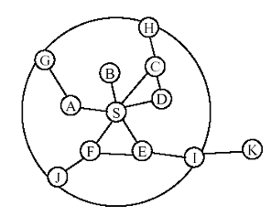
The Zone Routing Protocol
Based on the concept of zones
A zone is defined (how?) for each node separately
• Zone radius r given as number of hops
• The zones overlap
Peripheral nodes
G, H, J, and I
Neighbor nodes
B, C, ….
We depict zones as circles, but they are not.
Center of S-zone
r = 2 (hops)

Slide 71
The Zone Routing Protocol
Based on the concept of zones
A zone is defined for each node separately
• Zone radius r given as number of hops
• The zones overlap
Peripheral nodes
G, H, J, and I
Neighbor nodes
B, C, ….
We depict zones as circles, but they are not.
Center of E-zone
r = 2 (hops)

Slide 72
Proactive Intra-zone Routing
ZRP refers to the locally proactive routing component as IARP
IARP is not a specific routing protocols. Instead, IARP is a family of proactive routing protocols.
Each node maintains the routing info to all nodes in its zone
The updates are only local in the zone.
Reduces the maintenance costs to a limited zone

Slide 73
How does Intra Zone work ?
B
Node D’s Zone
C
A
I
D
E
H
T
J
M
S
G
W
X
F
L
U
K
R
Border Nodes as seen by Node D
V
Y
N
Q
Z
Zone Radius is 2
D maintains Routes for nodes in zone --IARP e.g. D knows route to G.
If node not found, resort to Inter zone search.
P
O

Slide 74
Reactive Inter-zone Routing
The globally reactive routing component is named IERP. IERP is responsible for discovering routes to destinations beyond a node’s routing zone.
For example, when S has a packet to send to x, IERP is responsible for discovering this route.
How does IERP work?

Slide 75
Bordercasting
Knowledge of local routing zone topology can be exploited to relay a query through the network. [Multicasting]
The node would direct the query message out only to its peripheral nodes. [based on routing table]
Compute a border-cast (multicast) tree and append the corresponding packet forwarding Instructions to the bordercast packet.

Slide 76
Bordercasting
Bordercast nodes would execute the same algorithm that the primary node executed which is:
Check to see if the destination can be found within its zone. (How ?).
If yes, send a route-reply back to the source, indicating the route to the destination.
If not, forward the route-request to its peripheral nodes which executes the same procedure.

Slide 77
Border Nodes as seen by Node D
How does IERP work ?
B
Node D’s Zone
C
A
I
D
E
H
T
J
M
S
G
W
X
F
L
U
K
R
To illustrate IERP let destination be Y
D bordercasts query to its border nodes.
J is a border node which bordercasts again -- to its border nodes N and R.
R bordercasts to its border nodes W,T and Z
Y is found.
V
Y
N
Q
Z
P
O

Slide 78
A Concrete Example of How IERP works.
S has a packet to send to x
X is not in S’s routing zone. S issues a route request using IERP. The request is bordercasted to the peripheral nodes (the gray ones). These gray nodes search their routing table for the destination. They don’t see the destination. So the border-casting process continues (at node I, J, G , and H).

Slide 79
An Example (cont.)
Node I bordercasts the request to its peripheral nodes (gray ones). Due to query control mechanisms, the request is not passed back to nodes D, F, and S.

Slide 80
An Example (cont.)
Finally, the route request is received by node T, which can find the destination in its routing zone. A rout reply is sent back to node S.

Slide 81
Discussion: ZRP
Single route query can return multiple route replies; the best route will be selected based on selected metric.
Given sufficient storage, nodes may remove the routing information accumulated in route request packet and store it in a temp route query cache. It reduces the length of query packet, decreases the query response time.
Initiate a global route search only when there is a substantial change for reducing the cost of route discovery. A broken link within an active path may be the cause. Local Path repair procedure is initiated. It replaces a broken link with a minipath between the link ends. A path update is generated and sent to the path’s endpoints. It may not be the shortest one. After some repairs, the path endpoints initiate a new route discovery for optimal path.

Slide 82
Discussion: ZRP
Neighboring routing zones heavily overlap, each node may forward a route request multiple times, more control traffic than flooding. The challenge is to steer the query outward from the original routing zone. It depends on routing zone architecture.
Redundant querying occurs when a route request arrives in a previously queried routing zone. Thus the nodes will be capable to detect their early visited zone.
A node will not relay a query packet to a target bordercast recipient either if that recipient lies inside the routing zone of a previously bordercast node or if this node has already relayed the query to this recipient. (Early Termination)

Slide 83
AODV: Motivation
Ad-hoc On demand Distance Vector Routing
Objective: Minimalist features: Minimal Control Overhead; Minimal route acquisition latency
Goal is to reduce the system wise broadcasts (as much as possible) compared to DSDV
No broadcast ; if the link status does not affect the ongoing communication.
In DSDV, local movements have global effects. Triggered broadcast is replaced by careful bookkeeping.

Slide 84
AODV
Route Requests (RREQ) are forwarded in a manner similar to DSR
It does not add any overhead to the packets carrying data.
When a node re-broadcasts a Route Request [source IP, Broadcast ID, current Seq no, Destination node IP, last known sequence no] & sets up a reverse path pointing towards the source
AODV assumes symmetric (bi-directional) links
When the intended destination receives a Route Request, it replies by sending a Route Reply (RREP)
Route Reply travels along the reverse path set-up when Route Request is forwarded

Slide 85
Route Requests in AODV
S
E
F
B
C
D
A
G
H
I
Represents a node that has received RREQ for D from S

Slide 86
Route Requests in AODV
Broadcast transmission
S
E
F
B
C
D
A
G
H
I
Represents transmission of RREQ
A node re-broadcasts a Route Request [source IP, Broadcast ID, current Seq no,
Destination node IP, last known sequence no]

Slide 87
Route Requests in AODV
S
E
F
B
C
D
A
G
H
I
Represents links on Reverse Path
Before re-broadcasting, [source IP, Broadcast ID] will be checked for avoid
Duplication; otherwise process it

Slide 88
Reverse Path Setup in AODV
S
E
F
B
C
D
A
G
H
I
To process the RREQ, the node sets up a reverse route entry for the
source node in the route table. Reverse route entry must have a lifetime
For processing the route request; the node have an un-expired entry & an
entry within routing table for that dest with equal or greater seq no

Slide 89
Reverse Path Setup in AODV
Y
Z
S
E
F
B
C
M
L
J
A
G
H
D
K
I
N
Node D does not forward RREQ, because node D
is the intended target of the RREQ

Slide 90
Forward Path Setup in AODV
Y
Z
S
E
F
B
C
M
L
J
A
G
H
D
K
I
N
Forward links are setup when RREP travels along
the reverse path
Represents a link on the forward path

Slide 91
AODV – Optimization
Useful optimization: An intermediate node with a route to D can reply to route request.
Faster operation.
Multiple routes to be used after discovering .
Expanding ring search technique.
Unused routes are expired (through a concept of Aging) and consequently discarded ……route maintenance will be easier.
Above optimization can cause loops in presence of link failures

Slide 92
Link Failure
A neighbor of node X is considered active for a routing table entry if the neighbor sent a packet within active_route_timeout interval which was forwarded using that entry
Neighboring nodes periodically exchange hello message
When the next hop link in a routing table entry breaks, all active neighbors are informed
Link failures are propagated by means of Route Error (RERR) messages, which also update destination sequence numbers

Slide 93
AODV: Routing Loops
A
B
C
D
E
Assume, link C-D fails, and node A does not know about it (route error packet from C is lost).
C performs a route discovery for D.
Node A receives the route request (via path C-E-A)
Node A replies, since A knows a route to D via node B
Results in a loop: C-E-A-B-C

Slide 94
AODV: Use Sequence Numbers
Each node X maintains a sequence number
acts as a time stamp
incremented every time X sends any message
Each route to X (at any node Y) also has X’s sequence number associated with it, which is Y’s latest knowledge of X’s sequence number.
Sequence number signifies ‘freshness’ of the route – higher the number, more up to date is the route.

Slide 95
Use of Sequence Numbers in AODV
S
Y
?
D
Dest seq. no. = 10
Has a route to D
with seq. no = 7
Seq. no. = 15
RREQ carries 10
Y does not reply, but
forwards the RREQ
Loop freedom: Intermediate node replies with a route (instead of forwarding request) only if it has a route with a higher associated sequence number.

Slide 96
Avoidance of Loop
DSN = Destination Sequence Number.
A
B
9
C
D
7
9
10
E
5
All DSN’s are for D
Link failure increments the DSN at C (now is 10).
If C needs route to D, RREQ carries the DSN (10).
A does not reply as its own DSN is less than 10.

Slide 97
Route Maintenance
Movement of nodes within the ad-hoc network affects only the routes containing those nodes; such a path is called Active Path.
Route maintenance will be triggered only for active session.
Route entries with an infinity metric are not immediately deleted as they contain useful current routing information.

Slide 98
Path Maintenance
3’
3’
1
3
1
Destination
Destination
Source
2
Source
2
4
4
Movement not along active path triggers no action
If source moves, reinitiate route discovery
When destination or intermediate node moves
upstream node of break broadcasts Route Error (RERR)
RERR contains list of all destinations no longer reachable due to link break
RERR propagated until node with no precursors for destination is reached

Slide 99
AODV: Summary
Routes need not be included in packet headers
Nodes maintain routing tables containing entries only for routes that are in active use
At most one next-hop per destination maintained at each node
DSR may maintain several routes for a single destination
Sequence numbers are used to avoid old/broken routes
Sequence numbers prevent formation of routing loops
Unused routes expire even if topology does not change

Slide 100
Location-Aided Routing (LAR)
Exploits location information to limit scope of route request flooding
Location information may be obtained using GPS
Expected Zone is determined as a region that is expected to hold the current location of the destination
Expected region determined based on potentially old location information, and knowledge of the destination’s speed
Route requests limited to a Request Zone that contains the Expected Zone and location of the sender node

Slide 101
Request Zone
Define a Request Zone
LAR is same as flooding, except that only nodes in request zone forward route request
Smallest rectangle including S and expected zone for D
Request Zone
D
Expected Zone
x
Y
S

Slide 102
Location Aided Routing (LAR)
Advantages
reduces the scope of route request flood
reduces overhead of route discovery
Disadvantages
Nodes need to know their physical locations
Does not take into account possible existence of obstructions for radio transmissions

Slide 103
Desirable Attributes: Routing Algorithm
Executes distributedly
provides loop-free routes
provides multiple routes
Establishes routes quickly
Minimizes communication overhead
Selects optimal path

Slide 104
Tora Attributes
On demand source initiated routing
Nodes only maintain information about adjacent nodes (distributed)
Provides multiple routes
Creates loop-free routes
Handles partitions by erasing routes

Slide 105
Motivation: TORA
Observation: In hilly terrain, routing to a river’s mouth is easy – just go downhill
Idea: Turn network into hilly terrain
Different “landscape” for each destination
Assign “heights” to nodes such that when going downhill, destination is reached – in effect: orient edges between neighbors
Necessary: resulting directed graph has to be cycle free
Route Creation: establish sequence of directed links from source to destination. this is done by forming destination oriented directed acyclic graph (DAG)

Slide 106
Directed Acyclic Graph
A graph G(V,E) is a directed graph with V nodes and E edges if every edge in the graph has an associated direction.
A directed graph with no cycles is a DAG.
A DAG is rooted at the destination if the destination is the only node with no downstream nodes, i.e., no links lead out of the destination. Such a DAG is often called a Destination oriented DAG.
Creation of such a DAG from a source to a destination would contain multiple routes to the destination.

Slide 107
Reaction to topology changes
Route Maintenance: Reaction to topology changes in order to reestablish routes
When link is removed that was the last “outlet” of a node, reverse direction of all its other links (increase height!)
Reapply continuously, until each node except destination has at least a single outlet – will succeed in a connected graph!
Route Erasure: When a partition is detected in the network, all invalid routes must be removed from the network. This is done by making directed routes undirected (erasing routes).

Slide 108
TORA Specification
Node Height in TORA
In TORA the height assigned to every node i is represented by a quintuple: H[i] = (τ, oid, r, δ, i)
The first three fields represent the reference level.
τ: a time tag indicating the “time” of link failure.
oid: originator-id – unique id of the node that defined the new reference level.
r: reflection bit – used to divide each reference level into 2 sub-levels

Slide 109
TORA Specification
Node Height in TORA
δ: integer used to order nodes with respect to unique reference level
i: unique identifier of the node
height of each node (except for the destination) is initially set to NULL: H[i] = ( -, -, -, -, i)
height of destination node d is initially set to ZERO: H[d] = (0, 0, 0, 0, d)
each node maintains a height array containing the heights of neighbours: H[i][k]

Slide 110
Route Creation
node C requires route to F and broadcasts QRY packet
(-,-,-,-,A)
(-,-,-,-,D)
(-,-,-,-,E)
(-,-,-,-,C)
QRY
(-,-,-,-,B)
(0,0,0,0,F)
: RT_REQ set
(-,-,-,-,G)
(-,-,-,-,H)

Slide 111
Temporally Ordered Routing Algorithm
Directed Acyclic Graph (DAG) rooted at destination is used to route packets
Link Reversal algorithm used to update DAG (along with notion of “height”)
Algorithm is distributed and loop-free
Recent result - Link reversal takes O(n²) time and message complexity to stabilize

Slide 112
TORA Example
A
B
F
C
E
G
Link (G,D) broke
D
Node G has no outgoing links

Slide 113
TORA Example
A
B
F
C
E
G
Represents a
link that was
reversed recently
D
Now nodes E and F have no outgoing links

Slide 114
TORA Example
A
B
F
C
E
G
Represents a
link that was
reversed recently
D
Nodes E and F do not reverse links from node G
Now node B has no outgoing links

Slide 115
TORA Example
A
B
F
C
E
G
Represents a
link that was
reversed recently
D
Now node A has no outgoing links

Slide 116
TORA Example
A
B
F
C
E
G
Represents a
link that was
reversed recently
D
Now all nodes (except destination D) have outgoing links

Slide 117
TORA Example
A
B
F
C
E
G
D
DAG has been restored with only the destination as a sink

Slide 118
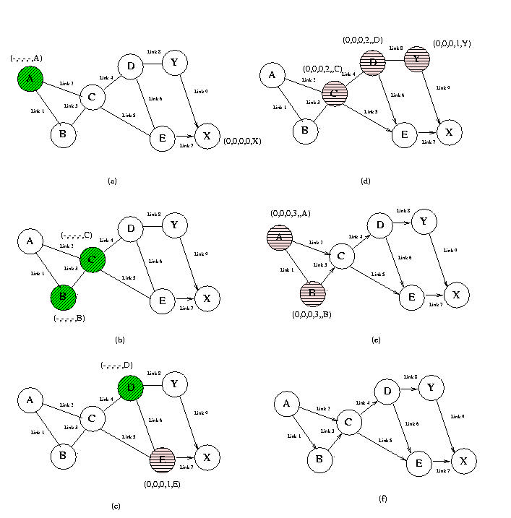
TORA: Example
• The destination is X.
• A needs to find a route to X.
• A sends a QRY packet to C.
• C and B broadcast this message.
•E knows that X is one hop away.
• D broadcasts QRY message (contains height which is
currently NULL).
• What does E do ?

Slide 119
Other routing protocols
Geographic Routing Protocols
Location Aided Routing (LAR)
Distance Routing Effect Algorithm for Mobility (DREAM)
Greedy Perimeter Stateless Routing (GPSR)
Hybrid Routing Protocols
Zone Routing Protocol (ZRP)

Slide 120
Clusterhead Gateway Switch Routing (CGSR)
Nodes organized into hierarchy of clusters.
Each node has a clusterhead, selected using an election.
Nodes send packet through clusterheads.
Clusterheads communicate amongst themselves using DSDV.
Two clusters are connected through a gateway node

Slide 121
Wireless Routing Protocol (WRP)
Maintains multiple tables
Distance, routing, link-cost, etc.
Link change messages exchanged only between neighbors
Loop freedom using novel algorithm
Uses predecessor hop information

Slide 122
Other Table-Driven Protocols
Optimized Link State Routing Protocol (OLSR) – RFC 3626
Optimization of link-state routing to wireless
Topology Dissemination Based on Reverse Path Forwarding (TBRPF) - RFC 3684
Also based on link-state routing

Slide 123
Scalability & Efficiency
Hierarchical solutions may reduce collisions in the wireless medium and facilitate the duty cycling of sensor nodes for increased energy efficiency.
Clustering may also facilitate the routing process, but may lead to longer routes than many flat routing protocols.
Clustering also facilitates in-network aggregation of sensor data, because data coming from co-located sensors (which may monitor overlapping regions of the environment) are likely to pass through the same cluster head.

Slide 124
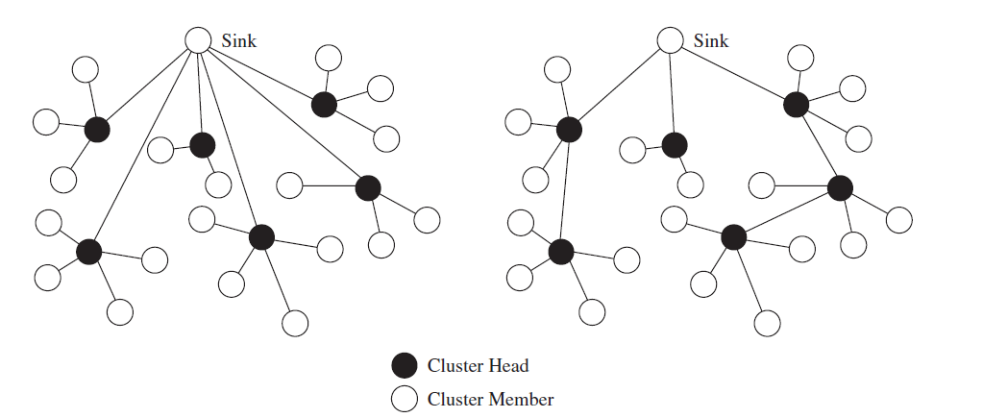

Slide 125
The Problem
The reason we need network protocol such as LEACH is due to the fact that a node in the network is no longer useful when its battery dies.
This protocol allows us to space out the lifespan of the nodes, allowing it to do only the minimum work it needs to transmit data

Slide 126
LEACH
Hierarchical clustering algorithm is the Low-Energy Adaptive Clustering Hierarchy that combines a clustering approach with MAC-layer techniques.
LEACH assumes that every cluster head can directly communicate with the base station.
Cluster heads are responsible for all communication between their cluster members and a base station and the aggregation of data coming from its cluster members in order to eliminate redundancies.

Slide 127
LEACH
LEACH can achieve significant energy savings (depending on how much redundancy can be removed) and sensor nodes (apart from the cluster heads) are not responsible for forwarding other nodes’ data.

Slide 128
LEACH’s Two Phases
The LEACH network has two phases: the set-up phase and the steady-state
The Set-Up Phase
Where cluster-heads are chosen
The Steady-State
The cluster-head is maintained
When data is transmitted between nodes

Slide 129
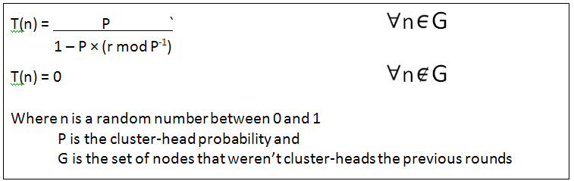
Stochastic Threshold Algorithm
Cluster-heads can be chosen stochastically (randomly based) on this algorithm:
If n < T(n), then that node becomes a cluster-head
The algorithm is designed so that each node becomes a cluster-head at least once

Slide 130
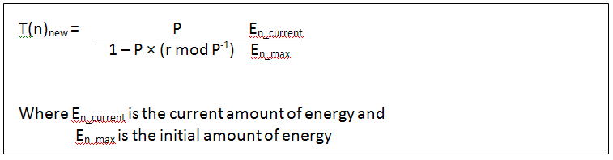
Deterministic Threshold Algorithm
A modified version of this protocol is known as LEACH-C (or LEACH Centralized)
This version has a deterministic threshold algorithm, which takes into account the amount of energy in the node…

Slide 131
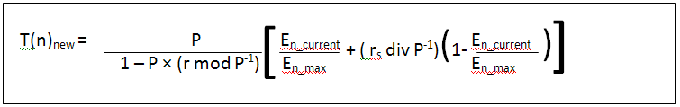
Deterministic Threshold Algorithm
…and/or whether or not the node was recently a cluster-head

Slide 132
LEACH: Operation
Periodic process
Three phases per round:
Advertisement
Election and membership
Setup
Schedule creation
Steady-State
Data transmission

Slide 133
LEACH: Advertisement
Cluster head self-election
Status advertised broadcast to nearby nodes
Non-cluster heads must listen to the medium
Choose membership based on signal strength
RSSI
E_{b}/N₀

Slide 134
LEACH: Setup
Nodes broadcast membership status
CSMA
Cluster heads must listen to the medium
TDMA schedule created
Dynamic number of time slices

Slide 135
LEACH: Data Transmission
Nodes sleep until time slice
Cluster heads must listen to each slice
Cluster heads aggregate/compress and transmit once per cycle
Phase continues until the end of the round
Time determined a priori
Notes:
Cluster heads die fast

Slide 136
LEACH: Interference Avoidance
TDMA intra-cluster
CDMA inter-cluster
Spreading codes determined randomly
Non-overlapping modulation may be NP-Complete
Broadcast during advertisement phase

Slide 137
What’s the Difference?
REMEMBER: The goal of these protocol is to increase the life of the network
The changes between the LEACH stochastic algorithm and the LEACH-C deterministic algorithm alone is proven to increase the FND (First Node Dies) lifetime by 30% and the HND (Half Node Dies) lifetime by 20%

Slide 138
Radio Model
Designed around acceptable E_{b}/N₀
E_{elec} = 50nJ/bit
Energy dissipation for transmit and receive
ε_{amp} = 100pJ/bit/m²
Energy dissipation for transmit amplifier
k = Packet size
d = Distance
Notes:
Receiving a message is not cheap
Eb/N0 is a kind of bit-level signal-to-noise ratio. Generally determined against a desired BER

Slide 139
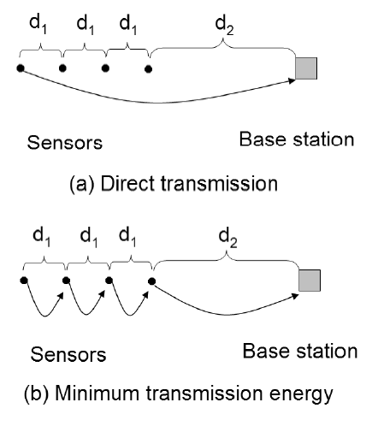
Direct v. Minimum Transmission
The amount of energy used in figure (a) can be modeled by this formula:
εampk(3d1 + d2)²
Whereas the amount of energy used in figure (b) uses this formula:
εampk(3d1² + d2²)

Slide 140
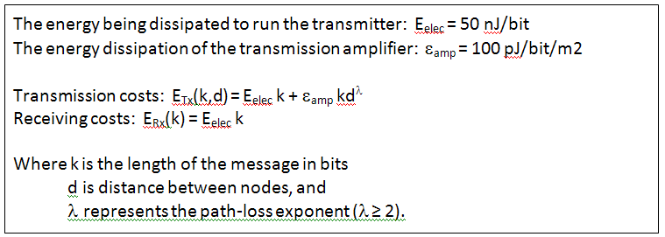
The Amount of Energy Depletion
This is the formula for the amount of energy depletion by data transfer:

Slide 141
MTE vs Direct-Transmission
When is Direct-Transmission Better?
when:
High radio operation costs favor direct-transmission
Low transmit amplifier costs (i.e. distance to the sink) favor direct transmission
Small inter-node distances favor MTE
For MTE, a node at distance nr requires n transmits of distance r, and n-1 receives

Slide 142
Existing Routing Protocols
LEACH is compared against three other routing protocols:
Direct-Transmission
Single-hop
Minimum-Transmission Energy
Multi-hop
Static Clustering
Multi-hop

Slide 143
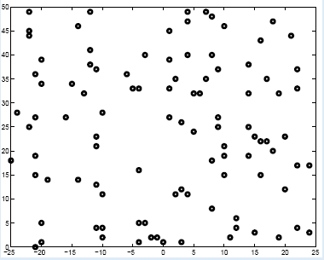
Performance: Parameters
MATLAB Simulator
100-node random network
E_{elec} = 50nj/bit
ε_{amp} = 100pJ/bit/m2
k = 2000 bits

Slide 144
Performance: System Lifetime
Experiments repeated for different maximum energy levels
LEACH gains:
8x life expectancy for first node
3x life expectancy for last node

Slide 145
Conclusions
LEACH is completely distributed
No centralized control system
LEACH outperforms:
Direct-Transmission in most cases
MTE in many cases
Static clustering in effectively all cases
LEACH can reduce communication costs by up to 8x
LEACH keeps the first node alive for up to 8x longer and the last node by up to 3x longer

Slide 146
